Slide 1


Creativity, Intuition, Emotions
& Perceptual Learning.
Potential fields for wider collaboration in cognitive sciences.
Włodzisław Duch & SCE Co.
Department of Computer Science,
School of Computer Engineering
Department of Informatics, Nicolaus Copernicus University
Google: Duch

Slide 2











The SCE Company
Geok See
Ng
Michel
Pasquier
Hiok Chai
Quek
Daming
Shi
Wlodek
Duch
Abdul Wahab
bin Abdul Rahman
David
Cho Siu Yeung
Douglas
Maskell
Alex
Tay Leng Phuan
Jagath
Rajapakse
Bertil
Schmidt

Slide 3
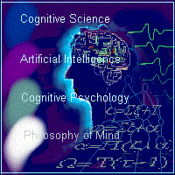
Plan
Neurocognitive model of mental processes.
Creativity: words in the brain, puzzles, 20 questions & avatars.
Intuition: learning manual skills, from conscious attention to subconscious automatic action; dynamics of mental skill training.
Emotions: inferring internal states for brain-based model of affective information processing.
Perceptual Learning: effects of intelligent interactions with infants on development of categorical perception and general intelligence.
Final discussion?

Slide 4
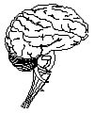
Neurocognitive approach
Computational cognitive neuroscience: aims at rather detailed neural models of cognitive functions, first annual CNN conf. 11-12.11.2005.
Neurocognitive informatics: focus on simplified models of higher cognitive functions: thinking, problem solving, attention, language, behavioral control and consciousness.
Many speculations, because we do not know the underlying brain processes, but models explaining most neuropsychological syndromes exist; computational psychiatry is rapidly developing since ~ 1995.
Even simple brain-like computing models provide real mind-like functions.
=> Complexity of the brain is not the main problem!
Brain As Complex System (BRACS, EU Project) central assumption: gross neuroanatomical brain structure is critical for its function, it should be preserved both at the cortex and subcortical levels.
“Roadmap to human level intelligence” – workshops ICANN’05, WCCI’06

Slide 5
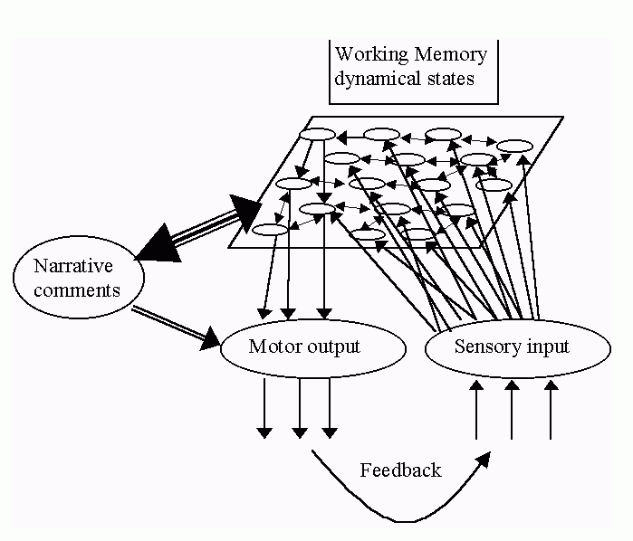
Simplest brain-like architecture
Brain states are physical, spatio-temporal states of neural tissue.
Cognitive processes operate on highly processed sensory data.
Redness, sweetness, pain ... are all physical states of brain tissue.
I can see, hear and feel only my brain states! Ex: change blindness.
Neural networks – only at level of single neurons, cortex is more a collection of many resonators creating dynamical configurations
competing for WM access.
Computers and robots do not have an equivalent of such WM.
In contrast to abstract computer registers dynamical brain states contain in themselves many associations and relations.

Slide 6
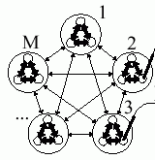
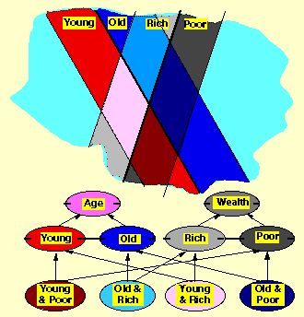
Dynamical system metaphore
Brain/mind as dynamical system was introduced in:
Thelen E. and Smith L.B. A Dynamic Systems Approach to the Development of Cognition and Action. MIT Press 1994.
Smith L.B. and Thelen E, Eds. A Dynamic Systems Approach to the Development. MIT Press 1994.
J. A. Scott Kelso, Dynamic Patterns. The Self-Organization of Brain and Behavior. MIT Press 1995
How to connect neuro with psyche ?
R. Shepard (BBS, 2001): universal psychological laws should be formulated in appropriate abstract psychological spaces; try to simplify neurodynamics => geometrical model of mental events.
K. Lewin, The conceptual representation and the measurement of psychological forces (1938), cognitive dynamic movement in phenomenological space.
George Kelly (1955), personal construct psychology (PCP), geometry of psychological spaces as alternative to logic.

Slide 7

Creativity
Still domain of philosophers, educators and a few psychologists, for ex. Eysenck, Weisberg, or Sternberg (1999), who defined creativity as:
“the capacity to create a solution that is both novel and appropriate”.
Journals: Creativity Research Journal, Journal of Creative Behavior.
E.M. Bowden et al, New approaches to demystifying insight.
Trends in Cognitive Science 9 (2005) 322-328.
fMRI activation for insight versus non-insight problem-solving were localized in the right-hemisphere anterior superior temporal gyrus (RH-aSTG).
Unrestricted fantasy? Creativity may arise from higher-order schemes!
Teaching creativity: Goldenberg et.al., Science v. 285 (1999), generated interesting advertising ideas using templates for analytical thinking, ideas that were evaluated higher than creative human solutions.
J. Goldenberg & D. Mazursky, Creativity in Product Innovation, CUP 2002

Slide 8
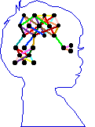
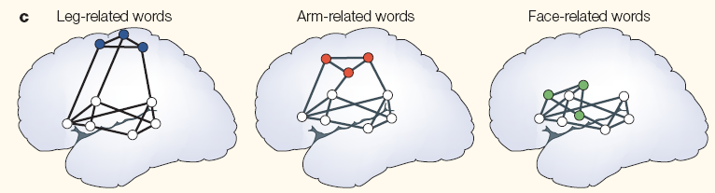
Words in the brain
Psycholinguistic experiments show that most likely categorical,
phonological representations are used, not the acoustic input.
Acoustic signal => phoneme => words => semantic concepts.
Phonological processing precedes semantic by 90 ms (from N200 ERPs).
F. Pulvermuller (2003) The Neuroscience of Language. On Brain Circuits of Words and Serial Order. Cambridge University Press.
Action-perception networks inferred from ERP and fMRI
Phonological neighborhood density = the number of words that are similar in sound to a target word. Similar = similar pattern of brain activations.
Semantic neighborhood density = the number of words that are similar in meaning to a target word.

Slide 9
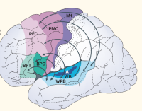
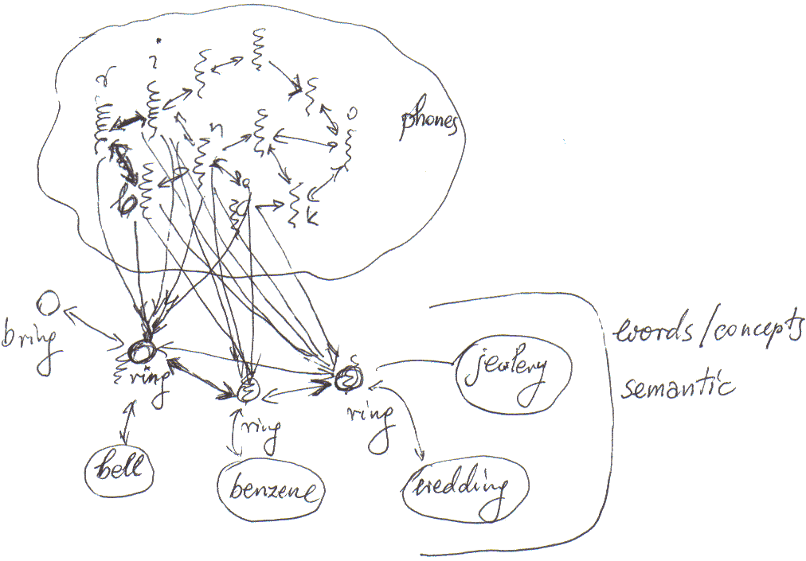
Words: simple model
Goals:
make a simplest test for creative thinking;
create interesting new names for products, capturing their characteristics;
understand newly invented words that are not in the dictionary.
Model inspired by (putative) brain process involved in creating new names.
Assumption: a set of keywords is given, priming the auditory cortex.
Phonemes are resonances (allophones), ordered strings of phonemes activate all candidate words and non-words; context priming + inhibition in the winner-takes-all process leaves only one concept (word meaning).
Creativity = imagination (fluctuations) + filtering (competition)
Imagination: many transient patterns of excitations arise in parallel, activating both words and non-words, guided by the strength of connections
Filtering: associations, emotions, phonological and semantic density.

Slide 10
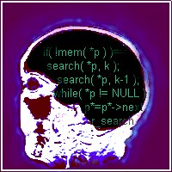
Words: algorithm
Neural resonant models (~ ARTWORD), or associative nets.
Simplest things first => statistical model.
Preliminary:
create probability models for linking phonemes and syllables;
create semantic and phonological distance measures for words.
Statistical algorithm to find novel words:
Read initial pool of keywords.
Find phonological and semantic associations to increase the pool.
Break all words into chains of phonemes, and chains of morphemes.
Find all combinations of fragments forming longer chunks ranked
according to their phonological probability (using bi- or tri-grams).
For final ranking use estimation of semantic density around morphemes
in the newly created words.

Slide 11
Words: experiments
A real letter from a friend:
I am looking for a word that would capture the following qualities: portal to new worlds of imagination and creativity, a place where visitors embark on a journey discovering their inner selves, awakening the Peter Pan within.
A place where we can travel through time and space (from the origin to the future and back), so, its about time, about space, infinite possibilities.
FAST!!! I need it sooooooooooooooooooooooon.
creativital, creatival (creativity, portal), used in creatival.com
creativery (creativity, discovery), creativery.com (strategy+creativity)
discoverity = {disc, disco, discover, verity} (discovery, creativity, verity)
digventure ={dig, digital, venture, adventure} new!
imativity (imagination, creativity); infinitime (infinitive, time)
infinition (infinitive, imagination), already a company name
journativity (journey, creativity)
learnativity (taken, see http://www.learnativity.com)
portravel (portal, travel); sportal (space, sport, portal), taken
timagination (time, imagination); timativity (time, creativity)
tivery (time, discovery); trime (travel, time)

Slide 12
Word games
Word games that were popular before computer games took over.
Word games are essential to the development of analytical thinking skills.
Until recently computer technology was not sufficient to play such games.
The 20 question game may be the next great challenge for AI, because it is more realistic than the unrestricted Turing test;
a World Championship with human and software players in Singapore?
Finding most informative questions requires knowledge and creativity.
Performance of various models of semantic memory and episodic memory may be tested in this game in a realistic, difficult application.
Asking questions to understand precisely what the user has in mind is critical for search engines and many other applications.
Creating large-scale semantic memory is a great challenge:
ontologies, dictionaries (Wordnet), encyclopedias, MindNet (Microsoft), collaborative projects like Concept Net (MIT) …

Slide 13
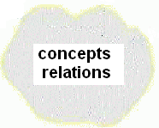
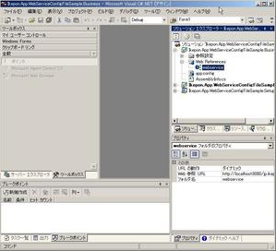


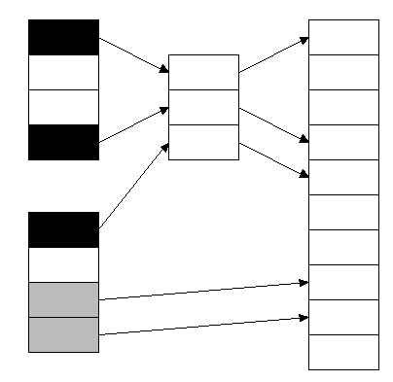
Query
Semantic memory
Applications, eg.
20 questions game
Humanized interface
Store
Part of speech tagger
& phrase extractor
verification
On line dictionaries
Parser
Manual

Slide 14

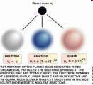
Puzzle generator
Semantic memory may be used to invent automatically a large number of word puzzles that the avatar presents.
This application selects a random concept from all concepts in the memory and searches for a minimal set of features necessary to uniquely define it; if many subsets are sufficient for unique definition one of them is selected randomly.
It is an Amphibian, it is orange and has black spots.
How do you call this animal?
A Salamander.
It has charm, it has spin, and it has charge.
What is it?
If you do not know, ask Google!
Quark page comes at the top …

Slide 15
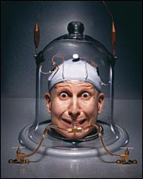
Creativity: future?
Better neural models, many variants of algorithm.
Same principles apply to creativity in design & other domains: imagination
restricted by probabilities, results filtered by … emotions? beauty? interest?
Assessing: who is better at invent new words, people or algorithms?
How good are people in 20Q game? We need references!
We need some tests to have a reference for humans: given a pool of keywords, come up with a good name for a new toy, software, company, product, web address, processor …
What really happens in the brain:
EPR and fMRI studies of brain activity during invention of new words and hearing of new words requiring analysis.
Applications:
names can be sold and copyrighted;
word games;
understanding new words.

Slide 16
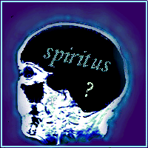
Intuition
Intuition: instinctive knowing, without the use of rational
processes (WordNet); knowledge or conviction gained
immediately and without detailed consideration (Wikipedia).
Typical belief about playing chess with computers: human intuition versus the brute force of millions of positions calculated per second.
Can computers have intuition? Yes, in many ways.
Parallel computational brain processes are hidden from the mind, but it does not mean that there are no computations behind human decisions.
Intuition is based on experience, complex evaluation of the case based on similarity to previous cases, but there is no sharp distinction between the use of logical rules and “intuitive” reasoning, see:
Duch W, Rules, Similarity, and Threshold Logic. Commentary on Emmanuel M. Pothos, The Rules versus Similarity distinction.
Behavioral and Brain Sciences Vol. 28 (1): 23-23, 2005

Slide 17
Intuitive thinking
Question in qualitative physics (from PDP book, 1986):
if R₂ increases, and R₁ and V_{t} are constant,
what will happen with current I, and voltages V₁, V₂ ?
Students can answer such questions without making explicit calculations, like writing and solving equations by making transformations.
How do we reason in such case?
We use intuition based on experience.
R₂ increases so the total resistance should be higher, so the current I should decrease, and therefore V₁ will also decrease, and to keep the total voltage V_{t} constant V₂ should increase.
No reference to equations; good students can answer any question about this system. How accurate are their answers? How complex may these questions be? What happens in their brains?

Slide 18
Expert system approach
One way to answer the question would be to create an expert system with knowledge of basic laws of physics, able to analyze equation, transform them and solve them. A lot of programming and not easy.
Symbolic algebra packages (like Mathematica) may solve the problem once we formulate it.
What useful knowledge do we have?
Kirchoff’s law: V_{t}=V₁+V₂
Adding resistances R_{t}=R₁+R₂
Ohm’s law: V=I*R, may be applied to each resistor and to total R:
V_{t}=I*R_{t} , V₁=I*R₁ , and V₂=I*R₂
Given information about R₂, R₁ and V_{t} find I, and voltages V₁, V₂
Calculate first R_{t}, then I=V_{t}/R_{t}, then V₁, and V₂.
Change of the problem => new transformations needed.

Slide 19
Qualitative physics
What is the basic relation that we learn? A=f(B,C), which is either
A=B*C (Ohm) or A=B+C (Kirchoff) or A⁻¹=B⁻¹+C⁻¹ (parallel resistors)
How is the change of A correlated with changes of B and C?
In all cases there are 13 true facts, ex: A grows if B and C grow, etc:
(A,B,C) = (+,+,+), (+,+,−), (+,−,+), (+,+,0), (+,0,+)
(0,+,−), (0,−,+), (0,0,0)
(−,−,−), (−,+,−), (−,−,+), (−,−,0), (−,0,−)
where +, 0, − means growing, staying constant and decreasing.
There are 14 false facts:
(A,B,C) = (+,−,0), (+,0,−), (+,0,0), (+,−,−)
(0,+,+), (0,+,0), (0,0,+), (0,0,−), (0,−,0), (0,−,−)
(−,+,+), (−,+,0), (−,0,+), (−,0,0)
Experience = learning of such relations by designated groups of neurons.

Slide 20
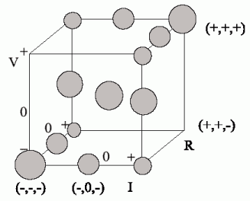
Psychological space representation
True facts are represented by local maxima of PDF, with dispersion for (+,+,+) fact larger than for (+,+,−) fact.
Amazing, but all 3-term formulas have identical representation in the feature space! 13 facts are and 14 false in 3D.
At the neural level: representation of activity of neural assemblies.
In the electric circuit example 7 variables are given, and all 5 laws that are applicable should be fulfilled.
How many facts are true in 7-D space? There are 3⁷=2187 possibilities
but only 111 consistent with all 5 laws!
How to calculate it?

Slide 21
Intuition in P-space
True facts correspond to inputs with non-zero PDFs. Since all 5 facts are true a product (chain of activations) must be non-zero:
There are 3⁷=2187 input combinations, but only 5% (111) correspond to true facts. After learning qualitative properties of F_{i}(A,B,C) relations, without any symbol manipulation, it is enough to check if F(X)>0
to recognize true facts! Choices are narrowed the more we know …
When F(X) is calculated drop all factors with unknown X_{i}
If R₂=+, R₁=0 and V_{t} =0, how the remaining variables may change?
Find missing values giving F(V_{t}=0,V₁,V₂,R_{t},R₁=0,R₂=+,I) > 0
Try to assume that the unknown variable R_{t} = −, check if is it possible.

Slide 22
Search in feature space
Since F(V_{t}=0,V₁,V₂,R_{t}=−,R₁=0,R₂=+,I)=0, then one of the laws is not fulfilled, so R_{t}=− is not possible. It does not matter which law, the system “intuitively” answers: impossible! Is V₁=+ possible? Yes.
Try different values and create
V₁ −
+
a search tree:
V₁=+,0,− are possible;
if V₁=− then V₂=−, 0 are not possible, so V₂=+ is the only possibility;
if V₁=0 then V₂=0 and if V₁=+ then V₂=− The search tree has only one solution.
0
V₂ +
−
R_{t} +
I −
Reasoning here is: assume that X₁ is something, is it possible?
If yes, then is X₂ possible? Is that what you will do solving such problem? We are usually a bit smarter, using some heuristics.

Slide 23

Useful heuristics
If a variable that we have considered first may take any value (is not constrained by intuitive knowledge) than it is not very informative.
Heuristics: use variable that has greatest constraints.
If a variable is found for which the search
terminates than there is no solution.
R_{t}=+
I=−
If the variable takes only one value the search is
greatly simplified: in our example R_{t} is the best variable since it may only grow; then I may only decrease, and that leads to a unique solution for the remaining two variables, V₁ and V₂.
V₁=−
V₂=+
A program based on this ideas may answer any question related to variable changes, and feasibility of constraints, for example, find all 111 possible situations that agree with all laws of physics.
Note that constraints may be soft! F(X) will measure overall agreement.

Slide 24
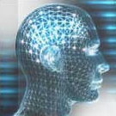
Intuition for mental & manual skills
Intuitive problem solving is not hard to model, either as neural, fuzzy, or similarity-based processes that reflect brain processes.
No comparison with experimental results so far (complexity, errors).
No results from brain imaging comparing logical vs. intuitive solutions?
Another aspect of intuition: knowing how to act without reasoning.
Learning new skills, such as car driving or using keyboard:
initially conscious involvement (large brain areas active) mysteriously becomes automatic, subconscious & intuitive (well-localized activity).
How can conscious become subconscious?
What is the role of consciousness here?
J. Taylor (2004) selected this problems as the most challenging for our understanding of the brain.

Slide 25
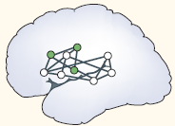
Automatization of actions
Learning of skills involves formation of perception-action distributed subnetworks, resonant attractor states of brain dynamics; such subnets are recruited from the beginning.
Reinforcement learning of new skills requires constant observing and evaluating how successful are the actions that the brain has planned and is executing, memorizing episodes for reference.
Relating current performance to memorized episodes of past actions requires evaluation and comparison (Gray conjecture – subiculum, part of hippocampal formation); cognitive evaluation is coupled with emotional reactions that provide reinforcement reward by dopamine release, facilitating rapid learning of specialized neural modules.
Working memory is essential to perform such complex task, as many observations should be brought together and be accessible to all brain subnetworks; errors are painfully conscious and remembered ...
Conscious experiences provide reinforcement;
there is no transfer from conscious to subconscious.

Slide 26
Stages of Skill Learning
At the cognitive stage initial (usually verbal) characterization of skill is used to guide behavior. Understanding instructions requires working memory capacity (frontal cortex), spatial imagination (parietal cortex, omitted in the simplified model) and access to long-term memory.
At the associative stage motor actions are produced (motor cortex), consequences of actions observed and evaluated (limbic system), with reinforcement learning rapidly tuning the behavior, eliminating errors and the need for verbal mediation and attention to basic movements.
At the autonomous stage skills are gradually improved via cerebellar learning making fine corrections to motor control signals, with little reliance upon working memory (blue connection).
This model will be implemented using PDP++ Neural Network Simulator (Randall O'Reilly, Univ. of Colorado, Boulder).

Slide 27
Model of Skill Learning
Long-term-memory
(neocortex)
working memory (prefrontal lobes)
Cerebellum
Motor cortex
(frontal lobes)
Actions
(muscles)
visual + auditory (temporal lobes)
Value/meaning and
spatial memory
(limbic system:
hippocampus + amygdala)
Motor sequences
(basal ganglia)
Input from the
environment
Key elements: working memory (frontal lobes), spatial memory storage and value-meaning associations (limbic system), long term memory storage (neocortex), learning of motor sequences (basal ganglia caudate and putamen nuclei, pre-motor and supplementary motor cortex), further improvements of initial skills due to cerebellar learning, and interaction with the sensory cortices (including proprioception) providing the input.

Slide 28
What is Emotion?
  “The core of an emotion is readiness to act in a certain way; it is an urgency, or prioritization, of some goals and plans rather than others. Emotions can interrupt ongoing action; also they prioritize certain kinds of social interaction, prompting, for instance, cooperation or conflict.”
  From N.H. Frijda, The Emotions, Cambridge, 1986.
  Emovere: A Neuro-Cognitive Computational Framework for Research on Emotions (David Cho & Co)

Slide 29

Emotions: motivations
Verbal information may not be the most significant part of interactions between humans, therefore emotions may play an important role in human-computer (and human-robot) interactions, and should be modeled in artificial systems.
Emotions are an important factor in intelligent behavior, including problem solving, because they can help to focus attention on correct reasoning, providing values for different options.
Understanding on how to capture real emotions in artificial system is an interesting and challenging problem.
Research on computational approaches to emotions is a state-of-the-art basic research topic.
Our Humanized InTerfaces (HITs), DREAM and intelligent tutor projects will benefit from affective computing.

Slide 30
HIT related areas
Learning
Affective
computing
T-T-S synthesis
Behavioral
models
Brain models
Speech recognition
HIT projects
Cognitive Architectures
Talking heads
AI
Graphics
Robotics
Cognitive science
Lingu-bots
VR avatars
A-Minds
Knowledge
modeling
Info-retrieval
Working
Memory
Episodic
Memory
Semantic memory

Slide 31
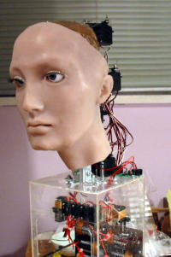
DREAM architecture
Web/text/
databases interface
Text to speech
NLP
functions
Natural input modules
Behavior
control
Talking
head
Cognitive functions
Control of devices
Affective
functions
Specialized
agents
DREAM is concentrated on the cognitive functions + real time control, we plan to adopt software from the HIT project for perception, NLP, and other functions.

Slide 32
Emotions: objectives
Neurocognitive computational framework for emotion
  Encoding of Emotional Tags
  Encoding of Episodic Memory using Emotional Tags and Emotional Expressions.
  Information flow between memory modules, computational model similar to the brain info flow
Fusion of Multiple Modal Inputs
  Facial, gesture, body posture, prosody and lexical content in speech.
Application
  Implementation and validation of the model in
  an Intelligent Tutoring System.

Slide 33
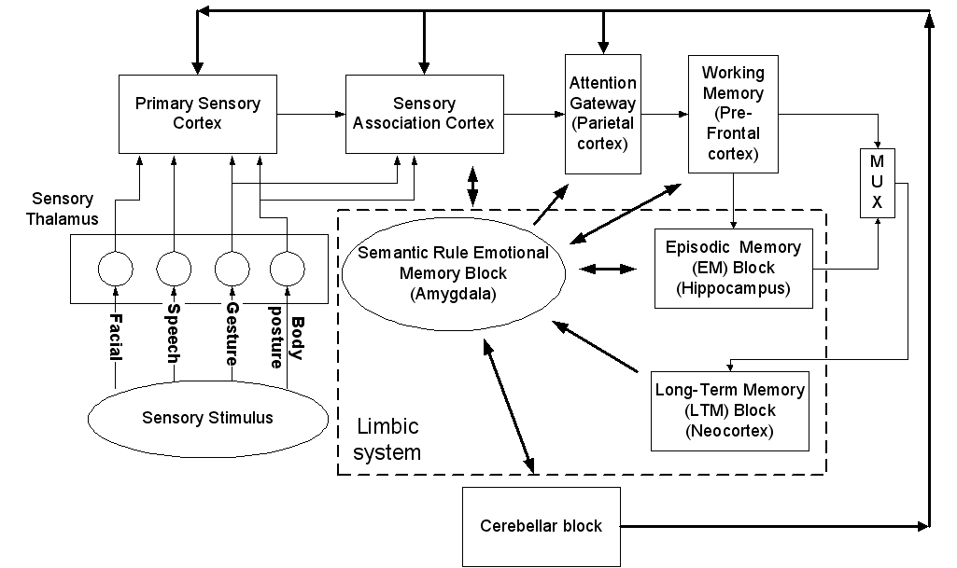
Proposed Neuro-Cognitive Framework

Slide 34
Emotions using visual cues: face, gesture, and body posture.
Emotional face processing
  Feedforward sweep through primary visual cortices ending up in associative cortices.
  Projections at various levels of the visual (primary) and the associative cortices to the amygdala.
  Activation of the prefrontal cortex initiate a re-prioritization of the salience of this face within the prefrontal cortex area.
  Amygdala generates or simulates a motor response providing effectively a simulation of the other person’s emotional state.
Emotional gesture processing is similar to face processing.
Emotional body posture understanding:
  Body movements accompany specific emotions.
  Coding schemata for the analysis of body movements and postures will be investigated.

Slide 35
Emotions using auditory cues: linguistic and prosody
Speech carries a significant amount of information about the emotional state of the speaker in the form of its prosody or paralinguistic content.
  Temporal recurrent spiking networks have already been used in identification of prosodic attitudes, but only using fundamental frequency, still 6 attitudes were distinguished with 82% accuracy.
  Primary and high level auditory cortices are involved in the extraction and perceptual processing of various prosodic cues.
  The amygdala and the pre-frontal cortex appears to be responsible for translating these prosodic cues into emotional information regarding the speech source.

Slide 36
Affect-based Cognitive Skill Instruction in an Intelligent Tutoring System
Intelligent Tutoring Systems (ITS)
  Integrating characteristics proper of human tutoring into ITS performance.
  Providing the student with a more personalized and friendly environment for learning according to his/her needs and progress.
  A platform to extend the emotional modeling to real life experiments with affect-driven instruction.
  Will provide a reference for the use of affect in intelligent tutoring systems.

Slide 37

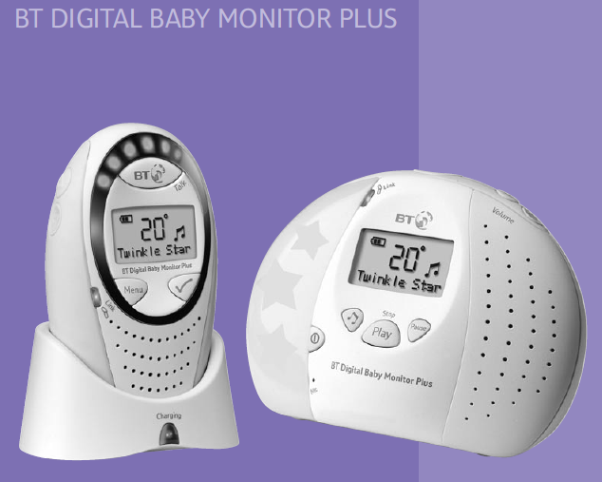
IDoCare: Infant Development & Care for development of perfect babies!
Perceptual Learning is an active field in psychology but rarely applied at the earliest stages of development.
Problem: about 5-10% of all children have a developmental disability that causes problems in their speech and language development.
Identification of congenital hearing loss in USA is at 2½ years of age!
Solution: permanent monitoring of babies in the crib, stimulation, recording and analysis of their responses, providing guideline for their perceptual and cognitive development, calling an expert help if needed.
Key sensors: suction response (basic method in developmental psychology), motion detectors, auditory and visual monitoring.
Potential: market for baby monitors (Sony, BT...) is billions of $; so far they only let parents to hear or see the baby and play ambient music.

Slide 38

IDoCare intelligent crib
Revolutionary enhancement of baby monitors: intelligent crib with wireless suction, motion detector and audio/visual monitoring, plus software for early diagnostics of developmental problems.
Hardware: embedding pressure and temperature sensors in telemetric pacifier, for monitoring and feedback of baby's reactions to stimuli.
Software: signal analysis and blind source separation; interpretation of baby’s responses, selection of stimuli and comments for parents.
Home applications: monitoring, diagnostics, preventive actions by enhancement of perceptual discrimination by giving rewards for solving perceptual problems.
Children love to be stimulated, and IDoCare will be the first active environment that will allow them to influence what they see and hear.
Active learning may gently pressure baby’s brain to develop perceptual and cognitive skills to their full potential achieved now by very few.

Slide 39


Phases, Resources & Alliances
Phase 1 (2008):
Build wireless pacifier for monitoring suction, temperature and heartbeat.
Use it in baby monitors; create a spin-off company to market it.
Collect data from many children and develop algorithms to interpret it.
Phase 2 (2011): Build intelligent crib with many sensors;
collect data and develop algorithms for interpretation, including
early diagnosis of hearing and speech impairments;
Stimulate and challenge babies using perceptual/cognitive games.
Phase 3 (2015):
IDoCare hi-tech cribs in every house; dyslexia and other problems
largely a thing of the past; follow-up studies show that children have perfect ear, speak foreign language with no accent, and have IQ>150;
Nobel prize in medicine awarded to our team in 2016.
Collaboration: KKH & Cincinnati Children’s Hospital Research
Foundation, Dept. of Biomedical Informatics.

Slide 40
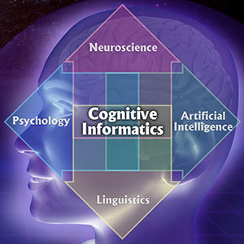
Discussion
We are interested also in many other CS subjects …
How to proceed in developing cognitive subjects at NTU?
Can we think about joint projects between CoE, HSS and NIE?
Developing courses at NTU? What would be the best form?

