Slide 1




Fuzzy Symbolic Dynamics for Neurodynamical Systems
Krzysztof Dobosz¹ and Włodzisław Duch²
¹ Faculty of Mathematics and Computer Science,
² Department of Informatics
Nicolaus Copernicus University, Toruń, Poland
kdobosz@mat.umk.pl, Google: W. Duch
ICANN 2008, Prague, 3-6 September 2008

Slide 2
Introduction
Neuroimaging data and simulated neurodynamical systems are characterized by multiple streams of nonstationary data
Understanding such signals is not easy because of high volume of data that quickly changes in time
Complex dynamics is usually described in terms of attractors, but precise characterization of their basins and possible transitions between them is never attempted
Various basis set decomposition techniques try to discover components that carry meaningful information which are used to analyze such signals, but these techniques tell us little about the activity of the whole system
Global analysis is needed to see attractors that trap dynamics, characterize the type of system’s behavior, notice partial desynchronization or high frequency noise that blurs the trajectories

Slide 3
Background:
Symbolic Dynamics (SD)
The signal space is partitioned into regions labeled with different symbols
Every time the system trajectory is found in one of these regions appropriate symbol is emitted
Sequence of symbols gives a coarse-grained description of dynamics that can be analyzed using statistical tools
Although discretization of continuous dynamical states looses the fluid nature of cognition, symbolic dynamics gives an appropriate framework for cognitive representations (Dale and Spivey, 2005)
Symbols obviously reduce the complexity of dynamical description but partitioning of highly-dimensional signal spaces into regions with sharply defined boundaries is highly artificial

Slide 4
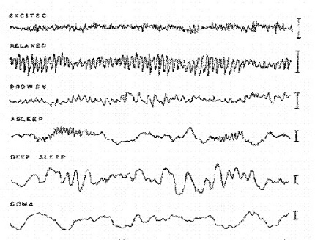
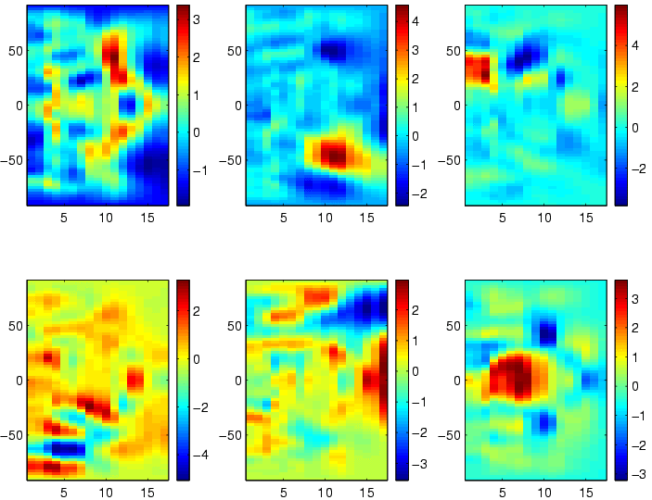
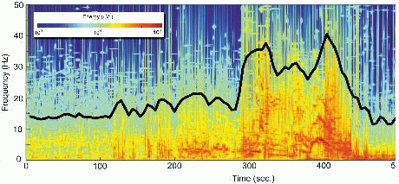
Fuzzy Symbolic Dynamics (FSD)
Fuzzy symbolic dynamics is a natural way to generalize the notion of symbolic dynamics
FSD may be used for dimensionality reduction, defining non-linear mapping for visualization of trajectories that shows various aspects of signals which are difficult to discover looking at individual components, or to notice observing dynamical visualizations
FSD can be applied to raw signals, transformed signals (for example, ICA components), or to signals defined in the time-frequency domain

Slide 5
FSD formulation
Trajectory of dynamical system (n-dimensional signal changing in time):
Instead of discrete partitioning (like in SD), interesting regions are determined analyzing probability density p(x) of finding the trajectory x(t) in some point x (averaging over time)
Local maxima of p(x) define quasi-stable states around which trajectories tend to cluster – they serve as centers μ_{k} of prototypes associated with fuzzy membership functions y_{k}(x; μ_{k}) that measure the degree to which the x(t) state belongs to the prototype μ_{k}.
Normalization of vectors in the signal space is assumed (in some cases standardization gives better results)

Slide 6
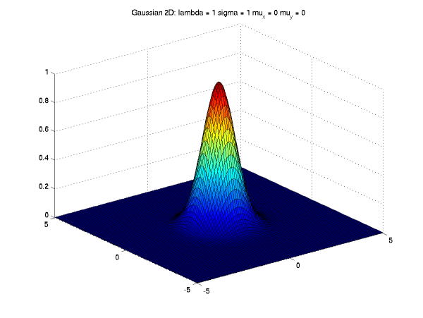
Example of membership function
For visualization Gaussian membership functions are quite useful:
Diagonal dispersions Σ_{k} are frequently sufficient, suppressing irrelevant signals
In general covariance matrices can extract more meaningful combinations of signals that correlate with experimental conditions, or with qualities that may be estimated in a subjective way

Slide 7
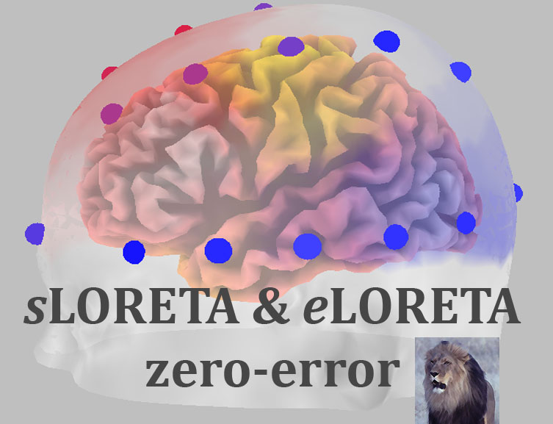
Plane and radial waves on a grid
A very simple artificial model has been created to understand the structure of complex EEG and similar signals
Sensors are placed on a quadratic grid with n×n points
Plane and radial waves are generated by several sources
Waves traveling through the grid create additive patterns and activate these sensors
Similar assumptions are made about electric potentials reflecting neuronal activity in the brain, for example in the low resolution electromagnetic tomography, LORETA,
http://www.unizh.ch/keyinst/loreta

Slide 8
The grid model
The grid has equally spaced points p_{ij} = (x_{i}, y_{j}) inside the square:
The activation of the sensor due to a plane wave in the grid point p_{ij} at time t = 0, 1, 2, . . . is given by:
Radial wave reaching the sensor at grid point p_{ij} leads to an activation:
The final activation of the sensor (sum and normalize all wave values):

Slide 9
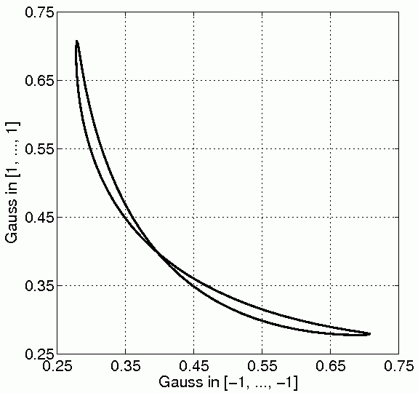
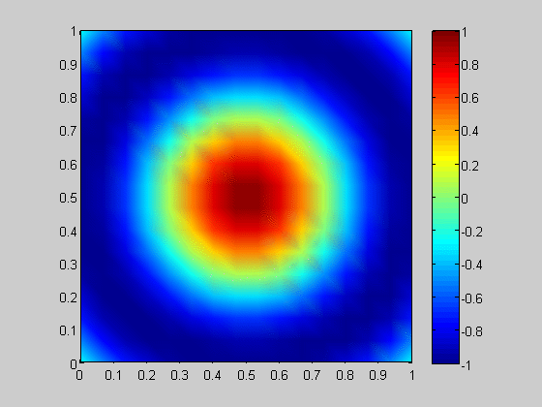
Trajectory for one radial wave
wave source: (½, ½) | n = 16 | k = 2π | ω = 0.2

Slide 10
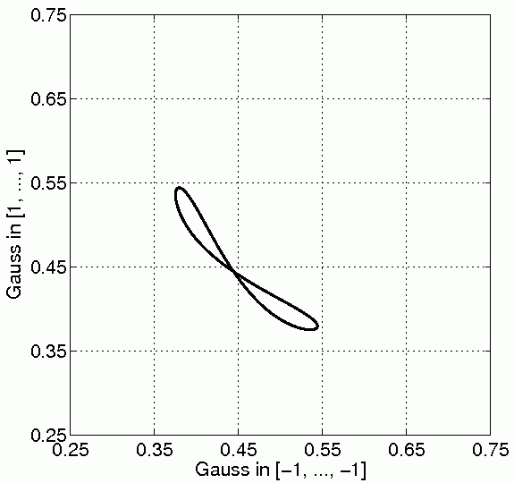
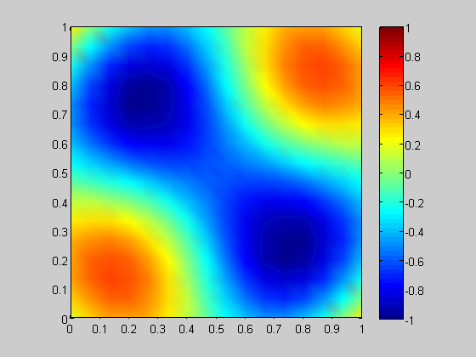
Trajectory for two radial waves
wave sources: (¼, ¼), (¾, ¾) | n = 16 | k = 2π | ω = 0.2

Slide 11
Neural Respiratory Rhythm Generator model (RRG)
Parametric neural network model; three populations of spiking neurons: beaters (200 in the model), bursters (50) and followers (50)
Reconstructing dynamics of brain stem structures responsible for rhythm generation
The follower population produce an output of the model activity that is used for synaptic excitation of motoneurons and in consequence control of upper and lower lung muscles
More information:
Companion paper: „Models of Respiratory Rhythm Generation in the Pre-Bötzinger Complex”, Butera et. al. 1999
(Laboratory for Neuroenginering, Georgia Tech)

Slide 12
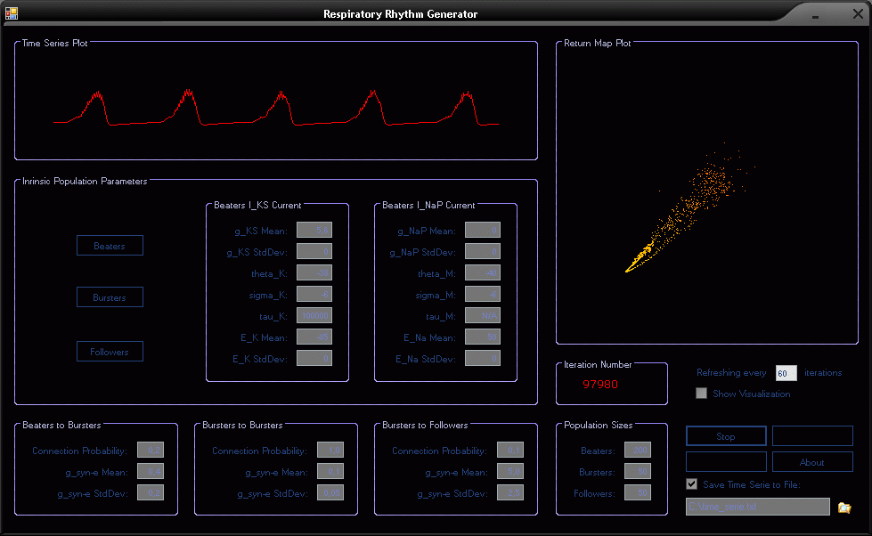
RRG Application

Slide 13
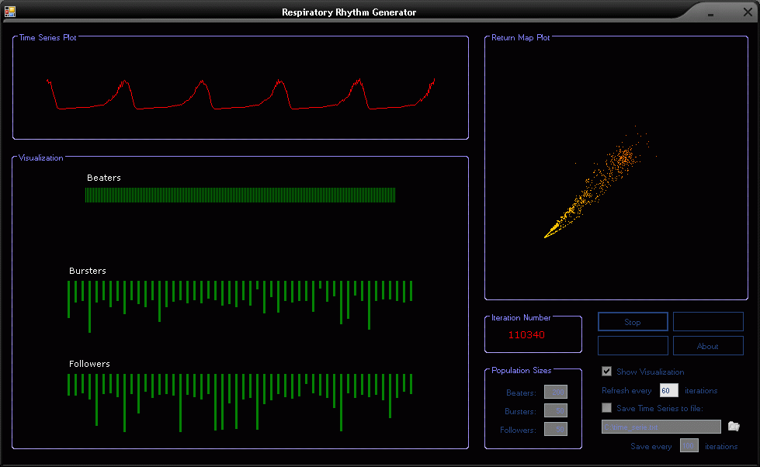
RRG Application

Slide 14
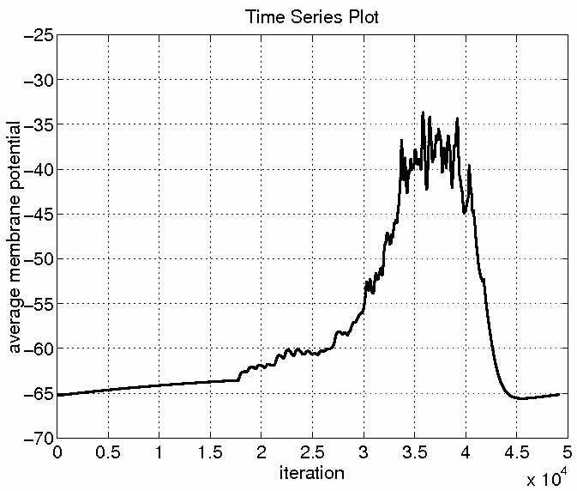
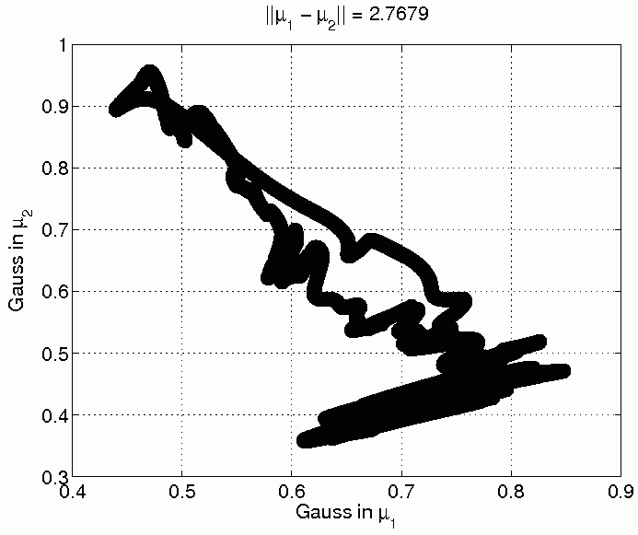
Time series plot for one burst and the corresponding trajectory
Clusterization done with the k-means algorithm, for two clusters where Gaussian probe functions have been placed

Slide 15
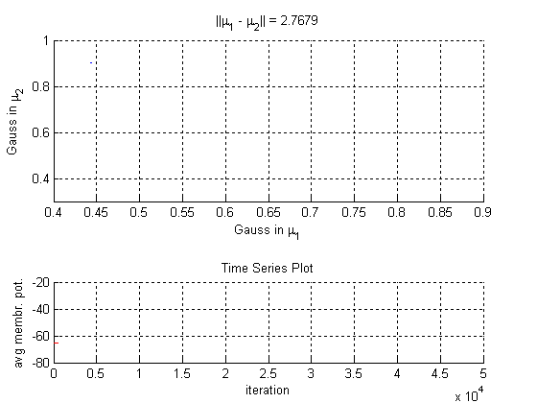
Animation of trajectory for one burst

Slide 16
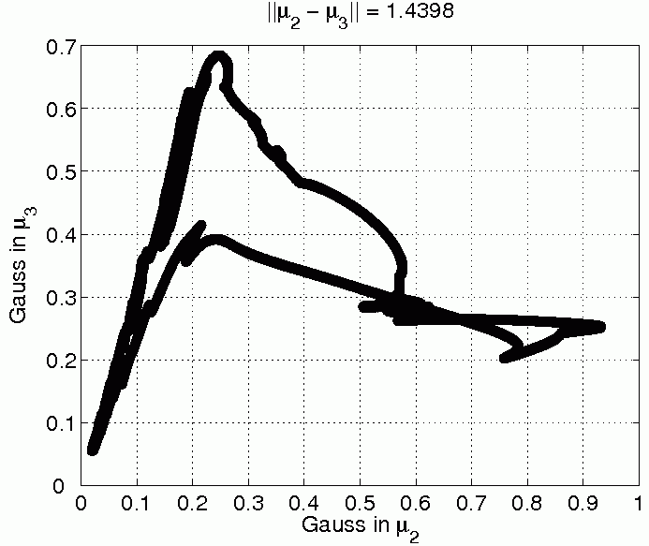
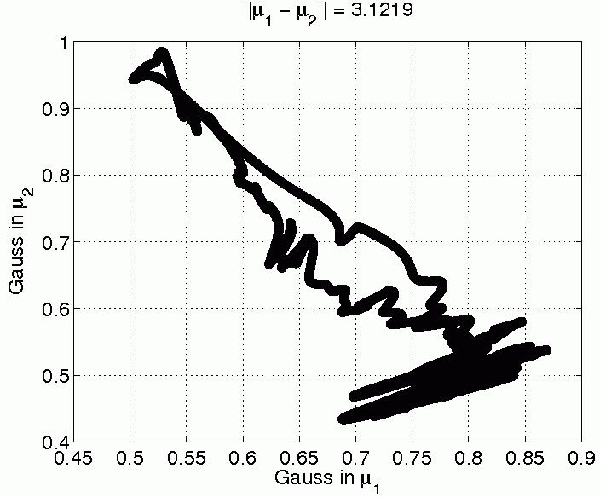
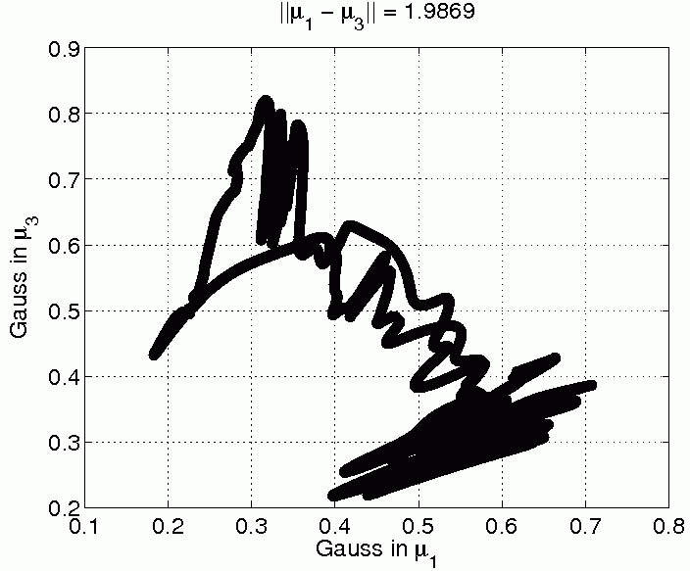
Pairwise diagrams for 3 clusters

Slide 17
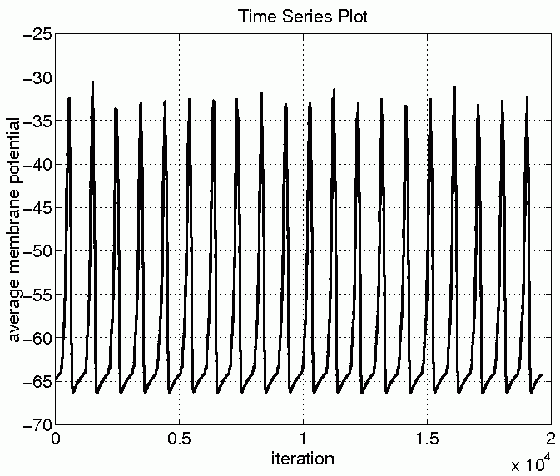
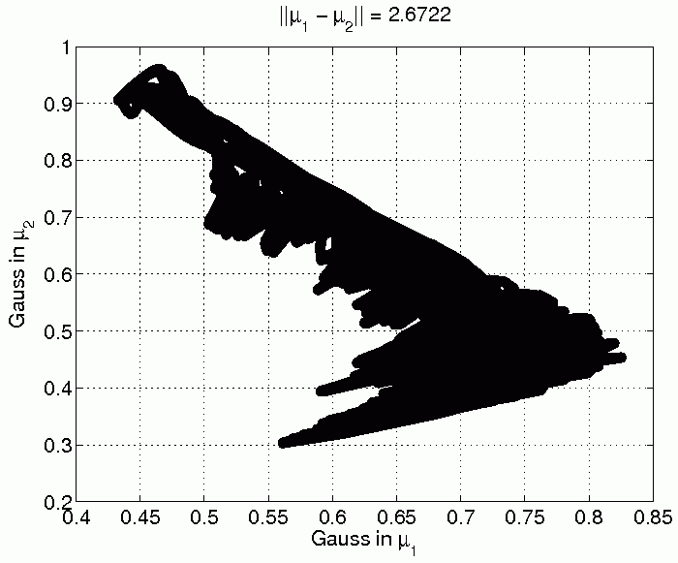
Trajectory for regular rhythm case

Slide 18
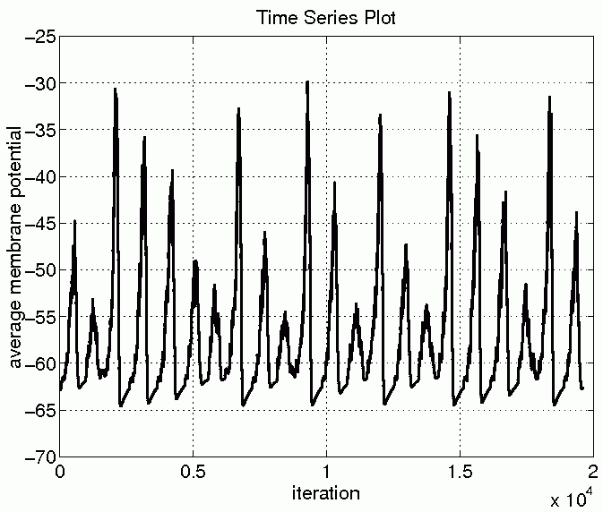
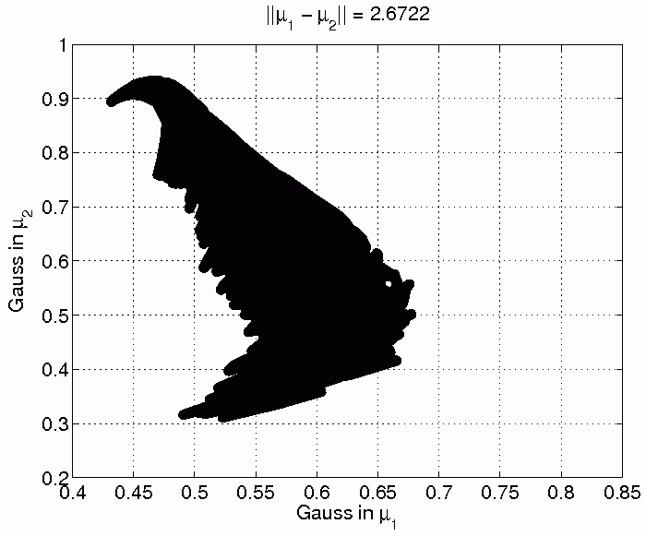
Regular vs. irregular rhythm case

Slide 19
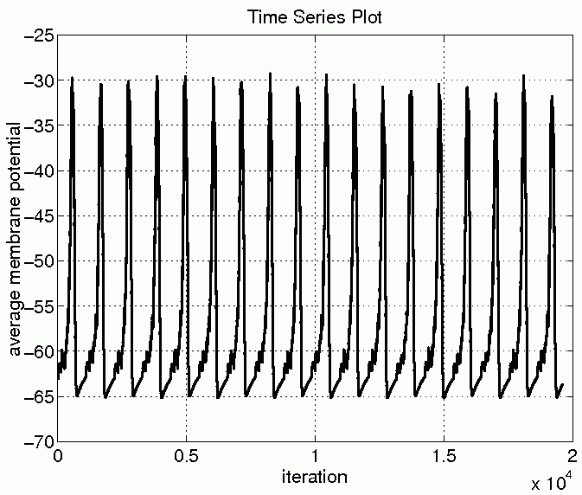
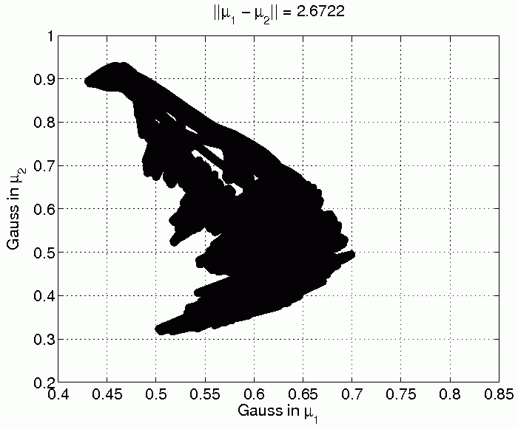
Two different regular rhythm cases

Slide 20
Epileptic EEG data
100 single channel EEG segments of 23.6-sec duration cut out from continuous multichannel EEG recordings after visual inspection for artifacts, e.g. due to muscle activity or eye movements
Sampling rate of the data was 173.61 Hz
The manuscript:
Andrzejak RG, Lehnertz K, Rieke C, Mormann F, David P, Elger CE (2001) Indications of nonlinear deterministic and finite dimensional structures in time series of brain electrical activity: Dependence on recording region and brain state, Phys. Rev. E, 64, 061907
http://www.meb.uni-bonn.de/epileptologie/science/physik/eegdata.html

Slide 21
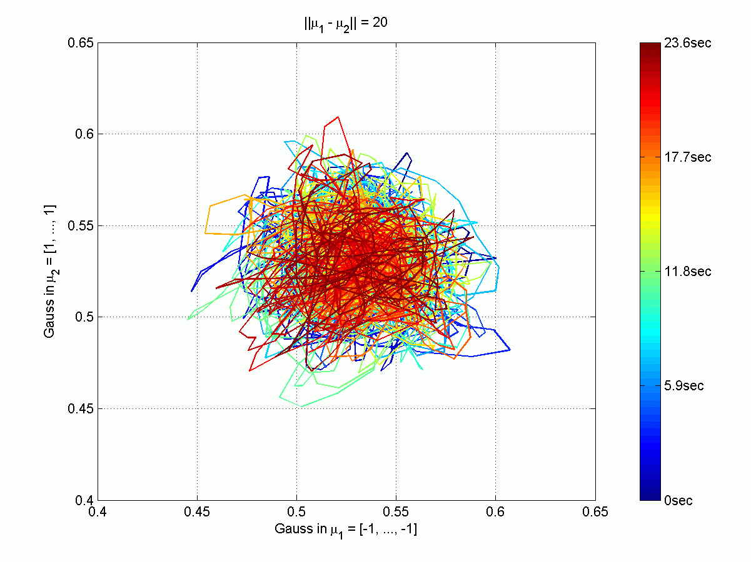
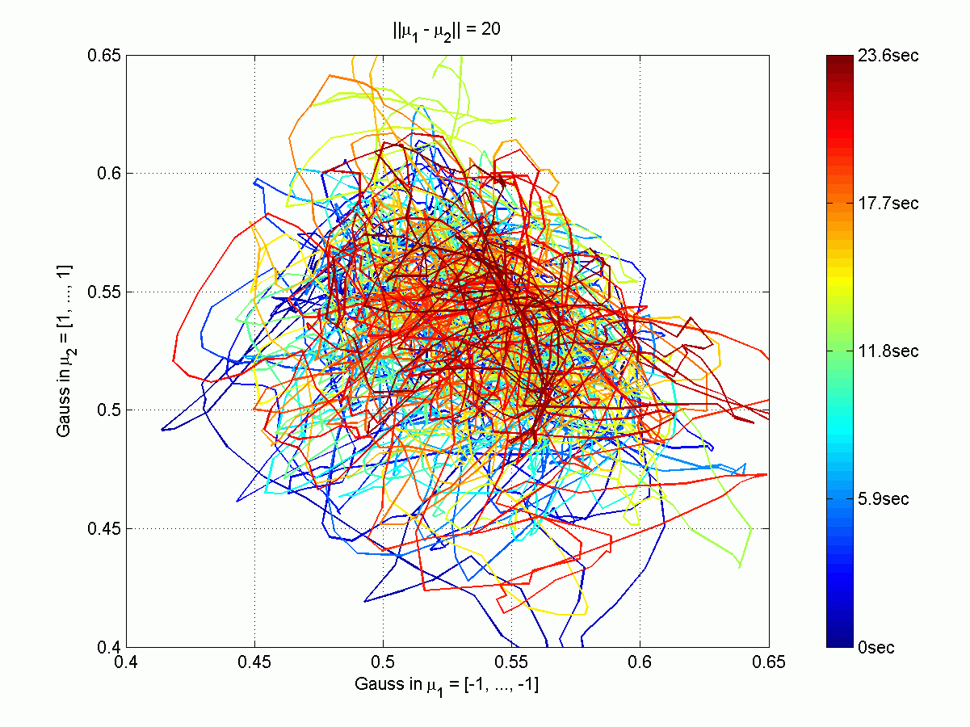
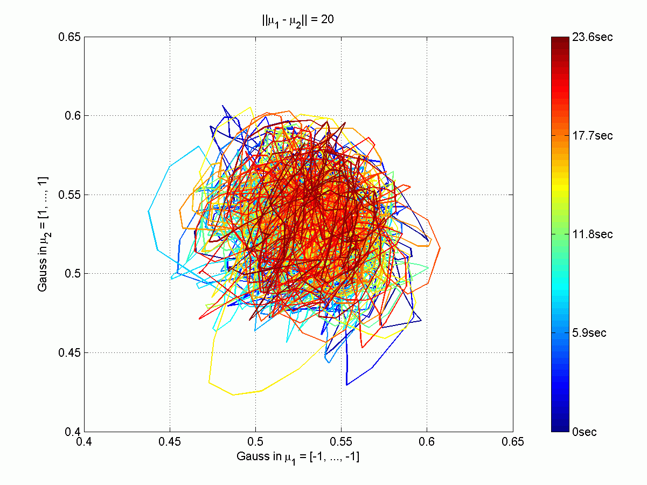
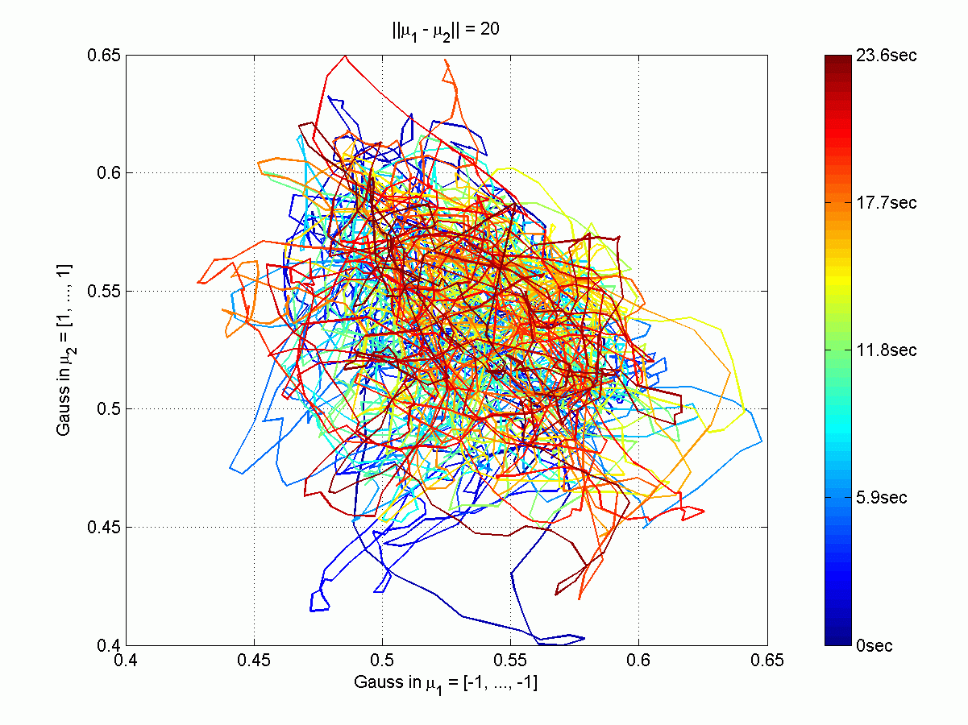
Trajectories for epileptic EEG data
4 different subjects; right – epileptic patients; left – control

Slide 22
Conclusions
Symbolic dynamics has found many applications, while its fuzzy version has never been developed
It seems to be a very interesting method that should find many applications
Many aspects of dynamics may be analyzed using this technique:
  In which part of the signal space the state of the system spends most of its time?
  How many attractors can be identified?
  What are the properties of basins of attractors (size, depths)?
  What are the probabilities of transition between them?
  What type of oscillations occur around the attractors?

Slide 23
Further work
Introduction of quantitative measures to compare different dynamical systems, for example:
  the number of attractors
  percentage of time spent by the system in a given attractor basin
  character of oscillations around attractors, including some measures of chaos
  distances between attractors, measured by the time of transitions
  probabilities of system transitions between attractors
Methods of parameter adaptation that include context will soon be applied to visualization of real experimental data
The great challenge is to find quantitative measures of the FSD representations that would be useful in brain computer interfaces

Slide 24
Thank you for attention
Contact: kdobosz@mat.umk.pl

